Slide 1
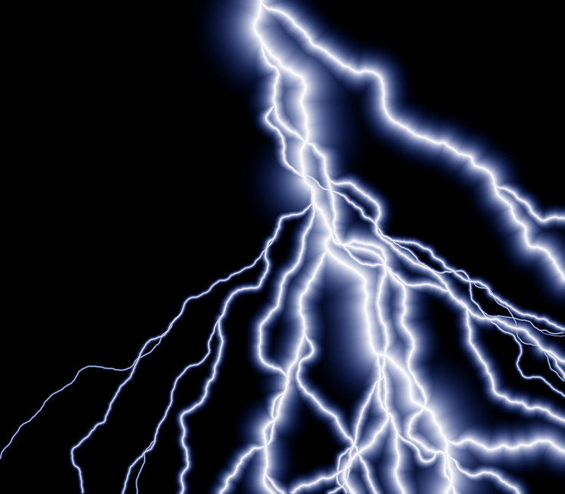

Slide 2
How far away is the storm?
Light travels much faster than sound. If you are near a thunderstorm you can determine
approximately how far away the storm is by counting the seconds between when you
see the flash and when you hear the thunder.

Slide 3
The Math
Take the number of seconds between flash and sound. Multiply this number by 1,200 (approx speed of sound ft/sec) then divide by 5280
Check your math with a storm distance calculator.
http://www.csgnetwork.com/lightningdistcalc.html

Slide 4
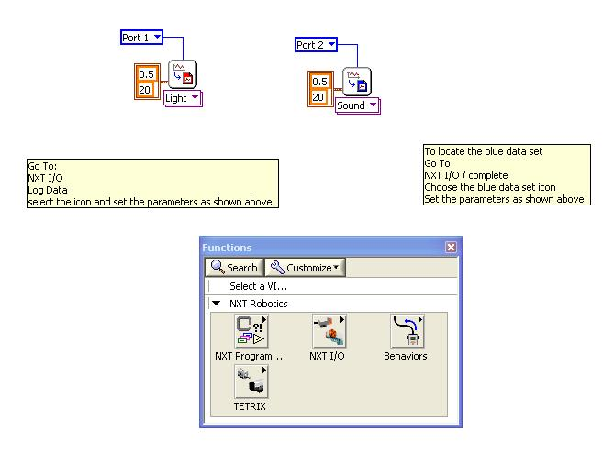
LabView program

Slide 5
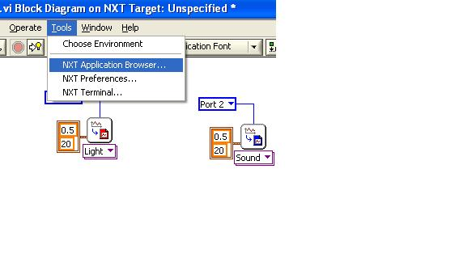
UPLOAD YOUR DATA

Slide 6
Click here
Then click on LAUNCH

Slide 7
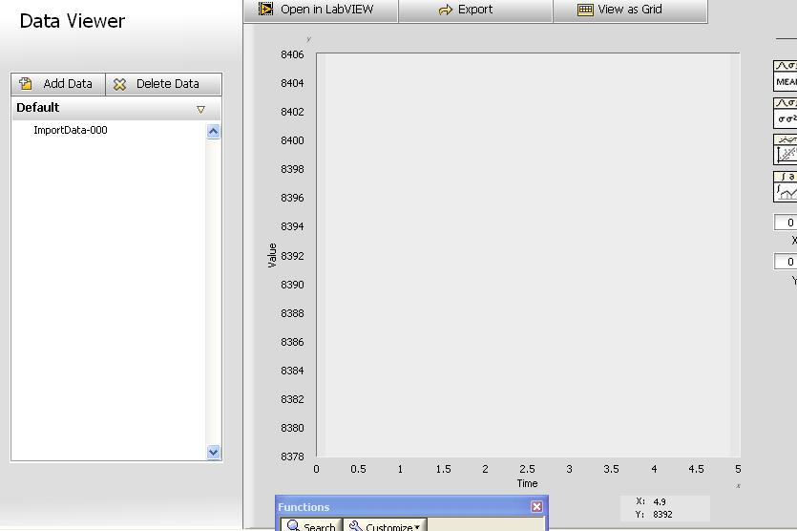
Click on add data to see your graph

Slide 8
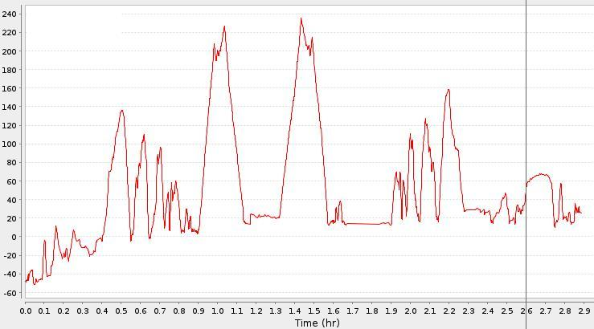
Analyze the data
When did the flash occur? When did the thunder occur?

Slide 9
Weebly
Show:
Your programs
Your graphs
Your math

